Slide 1

eHeart Gets New office

Slide 2

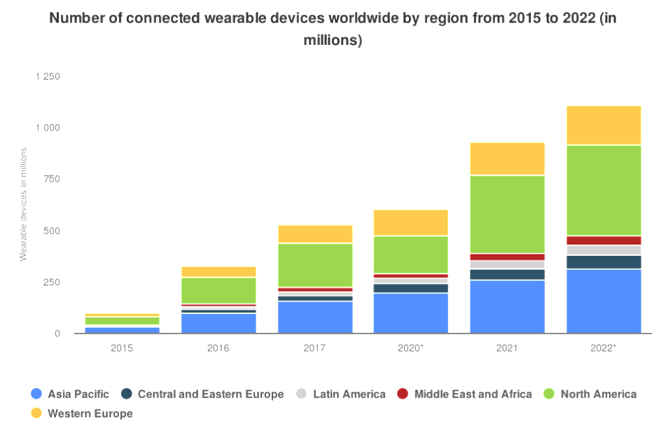
eHeart landing in the New World
The wearable technology market is expected to grow at highest rate, especially since COVID-19
North America represents the lion’s share

Slide 3
eHeart: health from within
The new office location should reflect eHeart cultural philosophy. We aim to improve the quality of life, so let’s start from within!
Cultural diversity
Green enviroment
Social Activity
Fitness (+ testing enviroment)

Slide 4
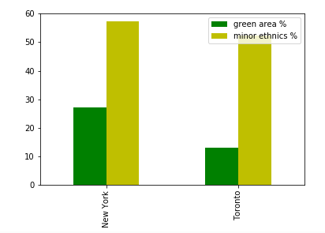
New York vs Toronto
New York and Toronto are both financial center of their respective countries
Both are culturally diverse with more than 50% of population with minority background.
New York, however, has a higher percentage of public green space, which almost doubles Toronto.

Slide 5
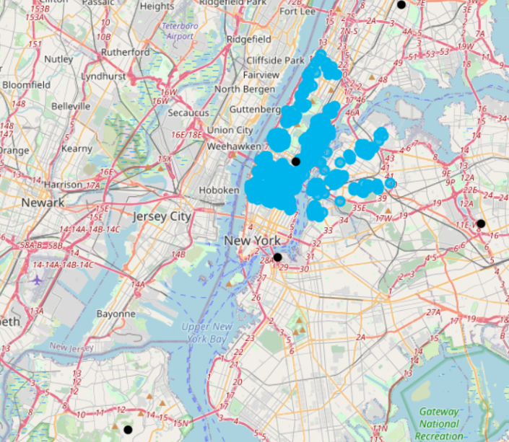
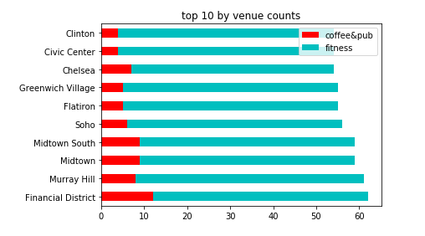
New York Neighborhoods
The neighborhoods with the most facilities such as pubs and gym are in Manhattan

Slide 6
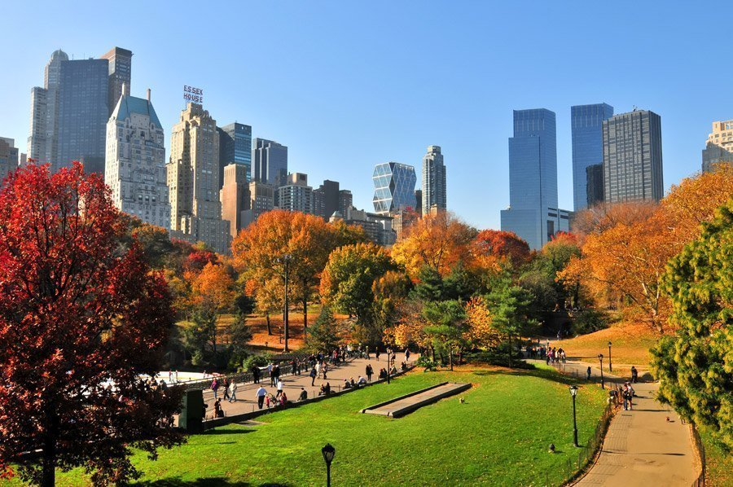
Conclusion
The ideal location for the eHeart North America office is in the area around Central Park, New York.

